Slide 1
Damages, Remedies, and Defenses
Student’s Name
Institutional Affiliation

Slide 2
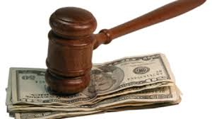
Damages
Damages are monetary awards that are supposed to be paid be paid to a victim in case of injury or loss.
The types of damages:
Special compensatory damages are monetary compensations that are paid to customers to cater the expenses they incurred in the treatment of an injury. A person can claim compensation incase of loss of earnings and future earnings.
General compensatory damages are compensations for non-monetary harm. Persons can claim compensation in this case when there is evidence of pain and suffering, loss of companionship, and mental anguish (All Law, 2020).

Slide 3

Cont.
Wrongful death damages are paid to the family of the deceased in case of death. In this regard, damages paid when there is evidence burial expenditure, pre-death care expenses, emotional distress among the family members, and loss of monetary contribution.
Punitive damages are only paid to plaintiffs that are injured when the defendant has acted wrongfully beyond reprehension.
For example, a defendant can be asked to award the damage if they acted maliciously or fraudulently.

Slide 4
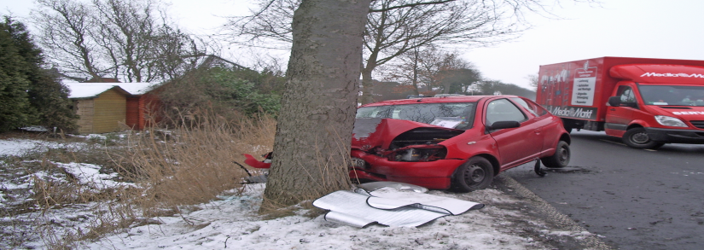
Remedies
The primary remedy for negligence is to provide damages to the victims.
The claimant has to prove that a breach in the duty of care.
Also, there must be evidence that the injury caused was ‘reasonably foreseeable.”
The duty of care is breached when injury or injury could not have happened in case proper care was observed.
Also, when the injury speaks for itself.
Lastly, when the defendant was the one was in charge of the situation.
For example, in clinical settings, a pharmacist can administer a patients with drugs that leads to the development of adverse medical outcomes that leads to him incurring expenses when seeking for further treatment. The patient can be remedied by offering them compensatory damages.

Slide 5
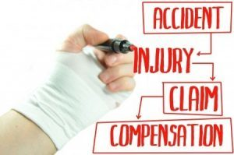
Defenses
Balance of probabilities can only be achieved when the claimant is able to provide satisfactory proof that the situation had 50.1% probability of occurrence.
In this regard, the claimant is expected to prove that the harm or injury was intentional or was due to negligence.
On the other hand, the defendant can use comparative negligence to show that the injury occurred under the watch of both the claimant and him/ her.
Assumption of risk argument can also be used to show that the harm is inherent in a certain process. Thereby, the defendant can waive the right to provide damages (Lumen Learning, 2020).
For example, a skydiver can sign a waiver with the service-provision firm with regards to assumption of injury in case of unexpected outcomes.

Slide 6

Difficult Negligence Elements
In car accidents, the burden of proof is occurs when the claimant has no evidence that the defendant does not have enough evidence of negligence of duty of care, especially, when multiple defendants are involved.
In this regard, an accident occurs where many vehicles are involved.
The defendants are likely to argue that they were only victims of circumstances and no control over their cars when the accident occurred.

Slide 7

Cont.
In the case of slip and fall, the claimant is faced with the burden of proof when the event causing the fall happened unawares.
For example, a defendant is likely to be not responsible for negligence of duty of care when he spilled oil unknowingly on the floor.
The automobile machinery he/ she was spilled oil accidently when moving around the factory.
Another worker steps on the oil and sustains a head injury just few seconds of the spillage.

Slide 8
References
All Law. (2020). Types of compensation in a personal injury case. Retrieved from
https://www.alllaw.com/articles/nolo/ personal-injury/types-of- compensation.html
Lumen Learning. (2020). General law of tort. ER services. Retrieved from https://courses.lumenlearning.com/suny- monroe-law101/chapter/general-law-of- torts/

